Slide 1
REDIS CACHE

Slide 2
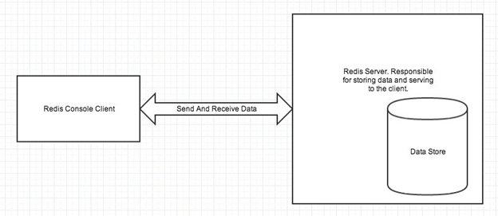
Redis is an open source (BSD licensed), in-memory data structure store used as a database, cache, message broker, and streaming engine.
Redis stands for REmote DIctionary Server.
Redis server is used to store data in memory . It controls all type of management and forms the main part of the architecture. You can create a Redis client or Redis console client when you install Redis application or you can use

Slide 3
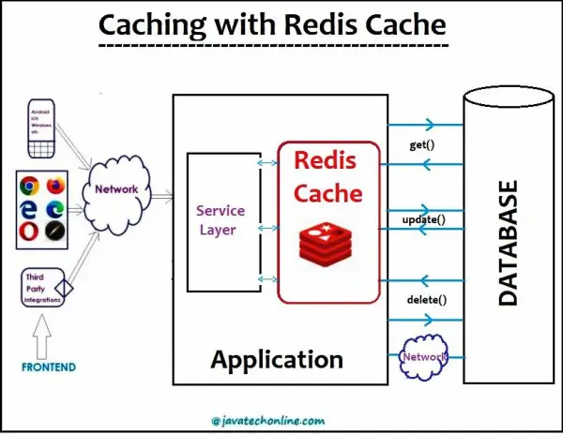

Slide 4
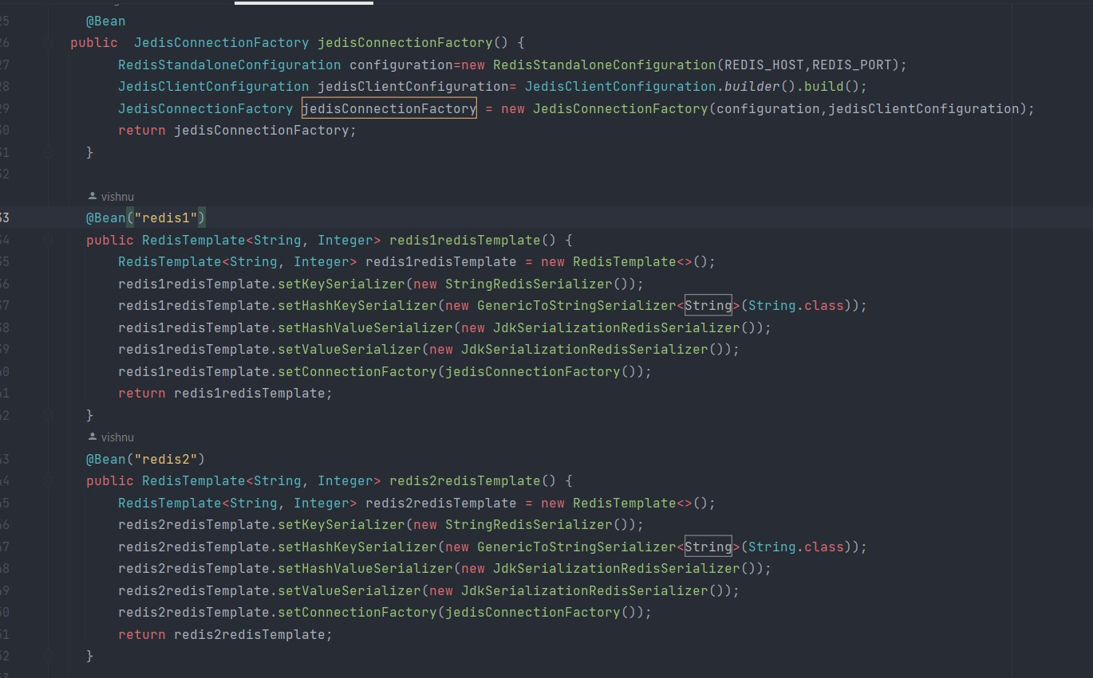
REDIS CACHE CONFIGURATION:

Slide 5
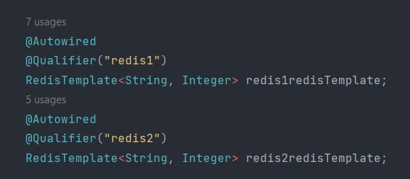
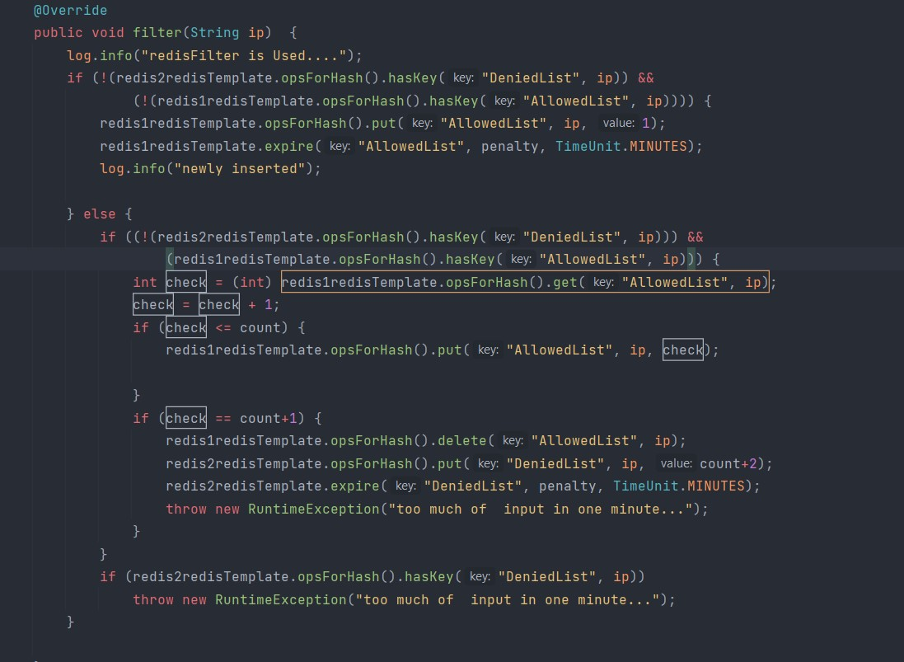
DEPENDENCY INJECTION:
REDIS TEMPLATE IMPLEMENTATION:

Slide 6
CONFIGURATION:
@Bean public RedisCacheConfiguration cacheConfiguration() {
Return RedisCacheConfiguration.defaultCacheConfig()
.entryTtl(Duration.ofMinutes(60)) .disableCachingNullValues().serializeValuesWith(
SerializationPair.fromSerializer(new GenericJackson2JsonRedisSerializer()));
}
TEMPLATE:
@Bean public RedisTemplate<String, Object> redisTemplate() {
RedisTemplate<String, Object> template = new RedisTemplate<>();
template.setConnectionFactory(jedisConnectionFactory());
return template; }
@Bean JedisConnectionFactory jedisConnectionFactory() {
JedisConnectionFactory jedisConFactory = new JedisConnectionFactory();
jedisConFactory.setHostName("localhost");
jedisConFactory.setPort(6379);
return jedisConFactory; }
we defined a RedisTemplate using the jedisConnectionFactory. This can be used for querying data with a custom repository.

Slide 7
ANNOTATIONS:
@Configuration
@EnableCaching
@Cacheable-to enable caching behavior for a method
@CacheEvict- to indicate the removal of one or more/all values
@CachePut- can update the content of the cache without interfering with the method execution. @CachePut will actually run the method and then put its results in the cache.
we can group multiple caching annotations with @Caching, and use it to implement our own customized caching logic.

